Slide 1
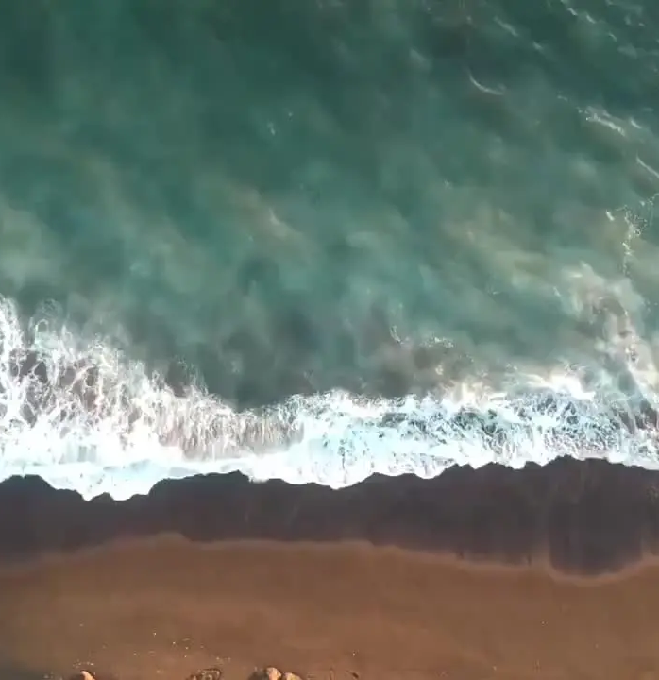

Growth Holdings
One CALA investment.
A platform for four to eight locations.
CLIVE COLLECTIVE
Confidential discussion draft
September 30, 2026
CALA GROWTH HOLDINGS
01
Notes:
CALA_Growth_Holdings_Investment_Overview.docx, discussion draft, retrieved September 30, 2026. Proposed terms, not approved offering terms.
Mikis Troyan to Jeff Ward, “Cala Fund and New Location Pipeline,” August 26, 2026. https://mail.google.com/mail/#all/1a04029b4f2e9767
Image asset from the official CALA website. https://cdn.ing/assets/i/r/153922/variants/eyzvp61cdmbhbeojmhap0gtjm97q/ffa771bd373b30a1a63111797ef5dd88627acefa289ede100f7c545462724c63/cala-hero.webp
Image asset from the official CALA website. https://cdn.ing/assets/i/r/153932/sv457a7ed6mw7mw2dnz5a6xl6oaa/logo-dark.png

Slide 2
The investment
4–8
A single investment in the CALA brand
and its restaurant portfolio.
CALA locations at target scale
Initial capital
Acquire the Scottsdale operation and develop Paradise Valley.
Future capital funds selected expansion opportunities.
The intended outcome is a sale or recapitalization of the combined platform.
Proposed platform strategy. Capitalization, timing and investor terms remain under development.
CALA GROWTH HOLDINGS
02
Notes:
CALA_Growth_Holdings_Investment_Overview.docx, discussion draft, retrieved September 30, 2026. Proposed terms, not approved offering terms.
Mikis Troyan to Jeff Ward, “Cala Fund and New Location Pipeline,” August 26, 2026. https://mail.google.com/mail/#all/1a04029b4f2e9767

Slide 3
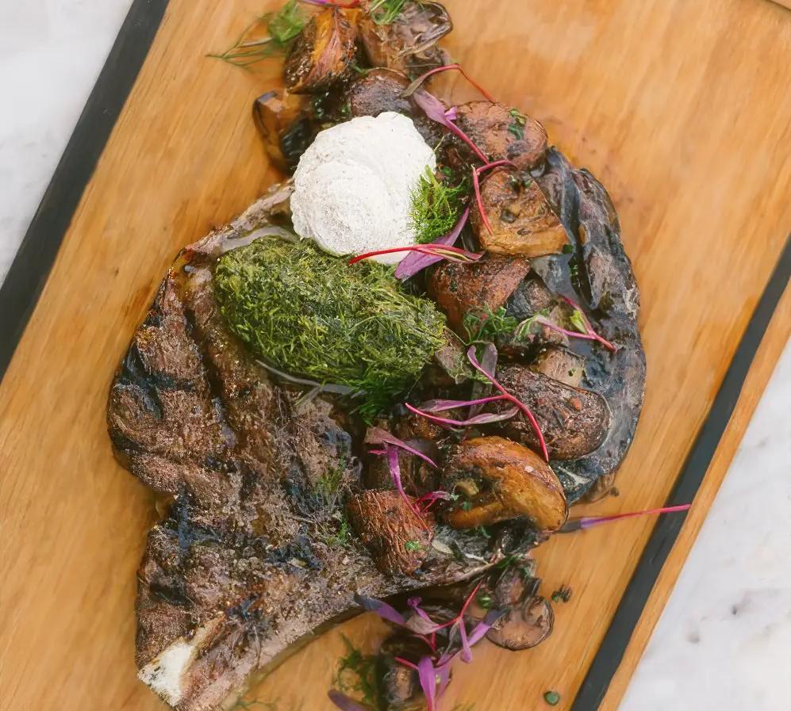
The CALA experience
Mediterranean coastal dining
Food inspired by the Mediterranean coast, with handmade pasta, fresh seafood and artisanal pizza.
An energetic restaurant experience with a distinctive design and a full beverage program.
CALA GROWTH HOLDINGS
03
Notes:
Brand description source: Senna House Hotel CALA page, retrieved September 30, 2026, https://www.thesennahouse.com/cala-restaurant.htm. Brand positioning is descriptive, not a forecast.
Image asset from the official CALA website. https://cdn.ing/assets/i/r/170721/u2d6jzkge1smk2xvf2rh1magumgm/food1.webp

Slide 4
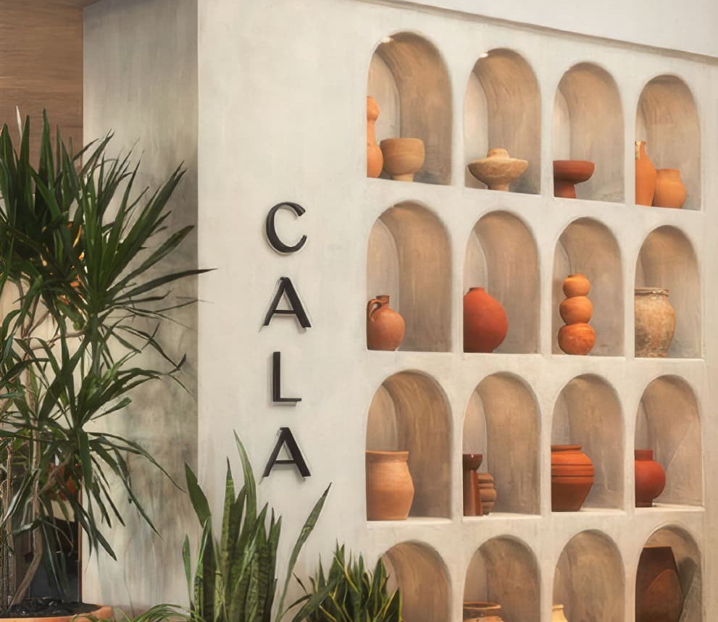
Clive Collective
Sponsor and operator
Mikis Troyan and Justin Massei
Clive would retain operating control and manage the CALA platform.
The platform plan includes site selection, restaurant development, operating standards and investor reporting.
Proposed sponsor responsibilities, subject to the management agreement and final offering documents.
CALA GROWTH HOLDINGS
04
Notes:
Mikis Troyan to Jeff Ward, “Cala Fund and New Location Pipeline,” August 26, 2026. https://mail.google.com/mail/#all/1a04029b4f2e9767
CALA_Growth_Holdings_Investment_Overview.docx, discussion draft, retrieved September 30, 2026. Proposed terms, not approved offering terms.
Image asset from the official CALA website. https://cdn.ing/assets/i/r/170701/b90sd69piv3zgaulfarrdyd30m0l/space-1.jpg

Slide 5
The initial portfolio
 | CALA Scottsdale | CALA Paradise Valley
Role | Existing operating anchor | New location at PV
Initial use of capital | Acquire equity in 7501 Scottsdale LLC or applicable entity | Development, pre-opening and contingency
Counterparty / stage | Purchase price and investor rollover to be finalized | RED Development Signed lease reported August 26
Underwriting needed | Current financials, liabilities and acquisition terms | Final budget, financing and opening schedule
Scottsdale acquisition remains proposed. PV lease status reflects the August 26, 2026 email.
CALA GROWTH HOLDINGS
05
Notes:
Mikis Troyan to Jeff Ward, “Cala Fund and New Location Pipeline,” August 26, 2026. https://mail.google.com/mail/#all/1a04029b4f2e9767
CALA_Growth_Holdings_Investment_Overview.docx, discussion draft, retrieved September 30, 2026. Proposed terms, not approved offering terms.

Slide 6
Paradise Valley
The first development project
RED Development at PV
Capital deployment
The email reported a signed lease, creating the initial development opportunity for the platform.
The initial raise would cover construction and pre-opening costs, with contingency and working capital.
PV provides the next test of CALA’s ability to operate beyond its Scottsdale location.
August 26 email anticipated construction in September. Actual start and opening dates require confirmation.
CALA GROWTH HOLDINGS
06
Notes:
Mikis Troyan to Jeff Ward, “Cala Fund and New Location Pipeline,” August 26, 2026. https://mail.google.com/mail/#all/1a04029b4f2e9767
CALA_Growth_Holdings_Investment_Overview.docx, discussion draft, retrieved September 30, 2026. Proposed terms, not approved offering terms.

Slide 7
The complete opportunity pipeline
Market | Property / relationship | Stage in email
Paradise Valley, AZ | PV / RED Development | Signed lease
Austin, TX | The Domain / Simon Property Group | LOI, second-generation
Fort Worth, TX | Clearfork / Simon Property Group | LOI, second-generation
San Diego, CA | Fashion Valley / Simon Property Group | LOI
Newport Beach, CA | Fashion Island / Irvine Company | LOI, second-generation
Salt Lake City, UT | City Creek | LOI
Santa Barbara, CA | Funk Zone | Opportunity identified
Source: email to Jeff Ward, August 26, 2026. Historical stages only. LOIs do not establish executed leases.
CALA GROWTH HOLDINGS
07
Notes:
Mikis Troyan to Jeff Ward, “Cala Fund and New Location Pipeline,” August 26, 2026. https://mail.google.com/mail/#all/1a04029b4f2e9767

Slide 8
Texas opportunities
Austin
Fort Worth
The Domain
Simon Property Group
Clearfork
Simon Property Group
Second-generation opportunity at LOI stage.
Second-generation opportunity at LOI stage.
Investment review: usable infrastructure, renovation scope, lease economics and staffing capacity.
LOI stages and second-generation descriptions reflect the August 26 email. No site budgets or returns supplied.
CALA GROWTH HOLDINGS
08
Notes:
Mikis Troyan to Jeff Ward, “Cala Fund and New Location Pipeline,” August 26, 2026. https://mail.google.com/mail/#all/1a04029b4f2e9767

Slide 9
Southern California opportunities
San Diego
Newport Beach
Fashion Valley
Simon Property Group
Fashion Island
Irvine Company
LOI stage. Build-out format and capital requirements remain to be confirmed.
LOI stage. The email identified a second-generation restaurant opportunity.
Site approval would depend on rent burden, development cost and the local operating model.
Historical stages from August 26, 2026. Fashion Island and Fashion Valley are distinct opportunities.
CALA GROWTH HOLDINGS
09
Notes:
Mikis Troyan to Jeff Ward, “Cala Fund and New Location Pipeline,” August 26, 2026. https://mail.google.com/mail/#all/1a04029b4f2e9767

Slide 10
Additional market opportunities
Salt Lake City
Santa Barbara
City Creek
LOI stage
Funk Zone
Opportunity identified
Next review: site terms, space condition, operating requirements and construction scope.
Next review: specific premises, control of the site, permitting and capital needs.
The pipeline supports choice. CALA would pursue only the locations that meet its investment criteria.
Historical stages from August 26, 2026. The email did not specify developers, site sizes or economics for these markets.
CALA GROWTH HOLDINGS
10
Notes:
Mikis Troyan to Jeff Ward, “Cala Fund and New Location Pipeline,” August 26, 2026. https://mail.google.com/mail/#all/1a04029b4f2e9767

Slide 11
Initial sources and uses
Initial use | Amount / decision required
Scottsdale acquisition | Purchase price, debt treatment and investor rollover
PV development and pre-opening | Final project budget and contingency
Platform and working capital | Corporate runway and operating reserves
Fees and transaction costs | Formation, acquisition and financing costs
Total initial equity raise | To be finalized after sources and uses reconcile
Potential sources: new equity, Scottsdale investor rollover and location-level financing, if approved.
Amounts are to be finalized. A restaurant’s total project cost is distinct from the parent’s equity raise.
CALA GROWTH HOLDINGS
11
Notes:
CALA_Growth_Holdings_Investment_Overview.docx, discussion draft, retrieved September 30, 2026. Proposed terms, not approved offering terms.

Slide 12
One parent investment
CALA Growth Holdings LLC
Investors would own interests in the parent platform.
Parent ownership
Restaurant subsidiaries
CALA brand and intellectual property, plus controlling interests in the restaurant entities.
Separate LLCs for Scottsdale, PV and each future restaurant, with location-specific leases and financing.
Proposed structure. Entity ownership, IP transfer and liability separation require final documentation.
CALA GROWTH HOLDINGS
12
Notes:
CALA_Growth_Holdings_Investment_Overview.docx, discussion draft, retrieved September 30, 2026. Proposed terms, not approved offering terms.

Slide 13
Expansion rounds
01
Price the new round
Establish the platform’s then-current value under a documented valuation process.
02
Offer existing investors participation
Give investors the right to fund their pro-rata share of the new round.
03
Admit additional capital
Issue units to participating and new investors. Nonparticipants dilute at the new round valuation.
Proposed approach. Fair-value issuance, participation rights and approval rules require a defined process.
CALA GROWTH HOLDINGS
13
Notes:
CALA_Growth_Holdings_Investment_Overview.docx, discussion draft, retrieved September 30, 2026. Proposed terms, not approved offering terms.

Slide 14
Proposed investor economics
Parent-level distributions
60%
1. Return investor contributed capital
2. Pay the cumulative, non-compounding
preferred return at a rate to be finalized
3. Split remaining distributable proceeds
Investors
40%
Clive
Management fee basis and rate: to be finalized.
Discussion terms only. The preferred return rate, management fee and complete waterfall remain to be finalized.
CALA GROWTH HOLDINGS
14
Notes:
CALA_Growth_Holdings_Investment_Overview.docx, discussion draft, retrieved September 30, 2026. Proposed terms, not approved offering terms.

Slide 15
Deployment and operating discipline
Before each site commitment
Before the next expansion round
Review the project budget, lease terms, downside cash needs and opening team.
Assess existing restaurant performance, available management capacity and remaining liquidity.
Investor reporting
Report restaurant performance, parent cash and debt, development spending, ownership changes and the capital plan.
Proposed approval criteria and reporting approach. No opening sequence or development dates are committed.
CALA GROWTH HOLDINGS
15
Notes:
Proposed operating plan for discussion, derived from the platform strategy in CALA_Growth_Holdings_Investment_Overview.docx, discussion draft, retrieved September 30, 2026. Proposed terms, not approved offering terms.

Slide 16
Risks and proposed controls
Principal risk | Proposed response
Construction cost and opening delays | Contingency, milestone funding and updated cost forecasts
Weak unit profitability or cash generation | Site-level downside underwriting and sufficient cash reserves
Growth outpaces the operating team | Stage openings around management and recruiting capacity
Valuation, dilution and sponsor conflicts | Document the pricing method, participation rights and approvals
Exit timing, liquidity and capital loss | Flexible hold period and realistic financing and sale assumptions
CALA GROWTH HOLDINGS
16
Notes:
Risk analysis and controls are discussion proposals, not claims that controls already exist. Sources: CALA_Growth_Holdings_Investment_Overview.docx, discussion draft, retrieved September 30, 2026. Proposed terms, not approved offering terms.
Mikis Troyan to Jeff Ward, “Cala Fund and New Location Pipeline,” August 26, 2026. https://mail.google.com/mail/#all/1a04029b4f2e9767

Slide 17
The intended exit
4–8
5–7 years
Locations at target scale
Indicative horizon
Strategic sale of the CALA platform
Private equity recapitalization
Portfolio transaction
Targets reflect the current one-pager. Scale, timing, proceeds and liquidity are not guaranteed.
CALA GROWTH HOLDINGS
17
Notes:
CALA_Growth_Holdings_Investment_Overview.docx, discussion draft, retrieved September 30, 2026. Proposed terms, not approved offering terms.
Mikis Troyan to Jeff Ward, “Cala Fund and New Location Pipeline,” August 26, 2026. https://mail.google.com/mail/#all/1a04029b4f2e9767

Slide 18
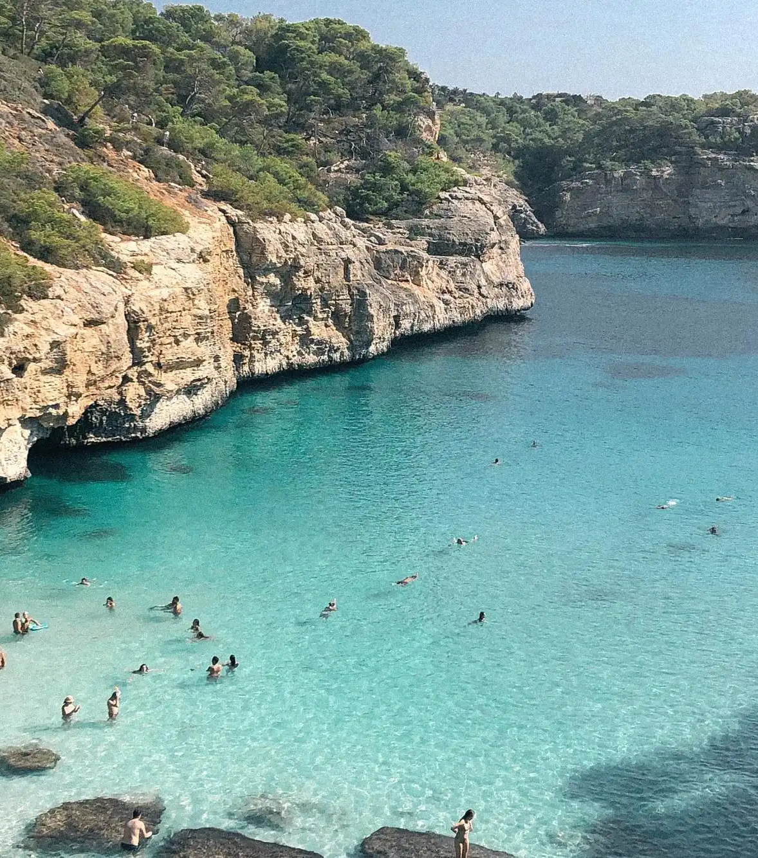
The initial investment discussion
Acquire Scottsdale. Develop PV.
Build a selective CALA portfolio.
Terms to complete
Scottsdale price and investor rollover
PV budget and financing
Initial equity raise and ownership
Preferred return, fees and governance
Mikis Troyan
mikis@weareclive.com
Confidential discussion draft. Not an offer to sell securities. Subject to diligence and definitive documentation.
CALA GROWTH HOLDINGS
18
Notes:
CALA_Growth_Holdings_Investment_Overview.docx, discussion draft, retrieved September 30, 2026. Proposed terms, not approved offering terms.
Mikis Troyan to Jeff Ward, “Cala Fund and New Location Pipeline,” August 26, 2026. https://mail.google.com/mail/#all/1a04029b4f2e9767
Image asset from the official CALA website. https://cdn.ing/assets/i/r/153928/vuocq081ojn242sh8f1ajqgmks2m/about.webp

Slide 19
Sources and proposal status
Opportunity pipeline
Email from Mikis Troyan to Jeff Ward, copied to Justin Massei, August 26, 2026. Includes all seven development opportunities and the proposed Scottsdale acquisition.
Platform and investor terms
CALA Growth Holdings Investment Overview, current discussion draft. Terms, amounts and the five-to-seven-year horizon remain proposals.
Pipeline stages reflect the source email. Current lease execution, availability, site economics and construction progress require updated confirmation.
CALA GROWTH HOLDINGS
19
Notes:
Mikis Troyan to Jeff Ward, “Cala Fund and New Location Pipeline,” August 26, 2026. https://mail.google.com/mail/#all/1a04029b4f2e9767
CALA_Growth_Holdings_Investment_Overview.docx, discussion draft, retrieved September 30, 2026. Proposed terms, not approved offering terms.
Public brand source: https://www.thesennahouse.com/cala-restaurant.htm.
Official image source: https://www.calascottsdale.com/. Asset URLs appear in the relevant slide notes.

